Slide 1

DevOps as a Culture

Slide 2
What is DevOps?
Cultural approach to software development project structure with a particular philosophy designed to achieve the following:
Increased collaboration
Reduction in silos
Shared responsibility
Autonomous teams
Increase in quality
Valuing feedback
Increase in automation

Slide 3
How Things Used to be Done
Software companies were structured into separate, stratified teams:
Development
Quality assurance (testing)
Security
Operations.
Teams tend to have varying and conflicting goals
Often poor communication
Isolated teams are referred to as silos
This structure regularly results in:
Slower releases
Wasted time and money
Blame cultures

Slide 4
How DevOps Changes Things Up
Based on agile project management
Designed to encourage flexible teamwork with the ability to fail (and recover) fast and celebrate achievements to promote a productive work culture
Agile focuses on bridging the gap between developers and customers

Slide 5
How DevOps Changes Things Up
DevOps focuses on bridging the gap between developers and operations teams
Historical friction between the developers and operations teams
Developers would generate code that broke the applications
Operations would throw code back to developers without sufficient details
Causes slower release times, inability to focus on their primary responsibilities, and general frustration within the organisation

Slide 6
Automation
Rule of thumb: if a machine could do it, a machine should be doing it
Manual work:
Human error
Slower development
Slower deployment
Automated work:
Consistent
Faster
Predictable
Scalable

Slide 7
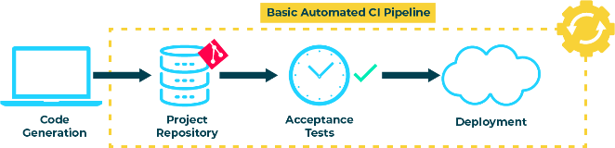
Automation

Slide 8
Continuous Integration
When code is committed to a repository, it is automatically built and subjected to acceptance tests
Test failures result in the code being prevented from integrating with the repository. Developers are immediately notified of a test failure so they can fix issues as quickly as possible

Slide 9
Continuous Deployment/ Delivery
As new code passes acceptance tests, it is automatically integrated into a deployment environment
Being able to choose a version to deploy with one push a button requires a fair amount of automation

Slide 10
INFRASTRUCTURE AS CODE
IaC is used to specify the configuration of a computer environment with easy-to-write/read config files
Having environment infrastructure declared in code allows for infrastructure to be created or modified using version control
Allows for simple replication of environments so they stay consistent across the pipeline

Slide 11
Measurement
Accurate and precise measurements allow us to pinpoint constraints in the pipeline and fix or improve them faster
Also important from a cultural standpoint as they can inform teams whether they're working more productively and what can be done to improve
We use metrics to measure our pipelines

Slide 12
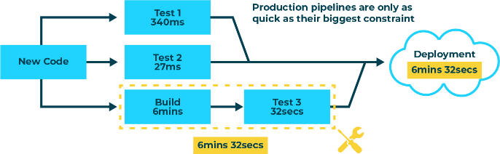
Measurement

Slide 13
Measurement
Frequency of deployment
DevOps pipelines encourage frequent, smaller updates to software, so charting the frequency of deployments is a good indicator of the effectiveness of a pipeline
Deployment frequency should tend upwards until it reaches a natural plateau, though fluctuation is normal
System availability
Systems should be available at all times to customers
Knowing the availability of our systems allows us to pinpoint which parts of our infrastructure need attention

Slide 14
Measurement
Service performance
Allows us to see whether our services are running within desired thresholds
e.g. response times per request, CPU load, how long it takes for a website to load
Mean time to recovery (MTTR)
Average time it takes to solve problems that impact the end-user
e.g. outages, security issues, severe bugs
More worthwhile metric than charting the frequency of failures as DevOps is less interested in minimising problems than the speed at which they are solved

Slide 15
Measurement
Mean time to discovery (MTTD)
This refers to how quickly problems are discovered
The faster problems are identified, the faster they can be fixed
Measured from the point of integration into production to the point the problem is identified
Faster MTTDs are more desirable.
Should also indicate whether discovery is made by the customer or the automated systems, with the latter being more desirable

Slide 16
Chapter 1 SDLC and Agile Recap

Slide 17
Agile Principles
Highest priority is to satisfy customer through early and continuous delivery of working software
Welcome requirement changes during development which enhance competitive advantage
Deliver working software frequently, from a couple of weeks to a couple of months, with a preference to the shorter timescale
Business people and developers must work together daily throughout the project
Build projects around motivated individuals. Give them the environment and support they need, and trust them to get the job done
The most efficient and effective method of conveying information to and within a development team is face-to-face conversation

Slide 18
Agile Principles
Working software is the primary measure of progress
Agile processes promote sustainable development. The sponsors, developers, and users should be able to maintain a constant pace indefinitely
Continuous attention to technical excellence and good design enhances agility
Simplicity – the art of maximising the amount of work not done – is essential
The best architectures, requirements, and designs emerge from self-organising teams
At regular intervals, the team reflects on how to become more effective, then tunes and adjusts its behaviour accordingly

Slide 19
Traditional vs Agile
Traditional Agile
Low-Level requirements are defined up front
Expects that low-level requirements evolve through understanding
Delivers fully developed system
Delivers increments of system in an iterative manner
Contingency in resource
Contingency in prioritised requirements
Typical user involvement at start and end of project
Planned active user involvement throughout the lifecycle
Notes:
Requirements evolve
AGILE recognises the challenge of defining detailed requirements upfront. For example, imagine describing the layout of your garden, when you are staring at the greenfield that you are planning to build your house on. Agile recognises how hard this is and plans for it, using prototyping and iterative/incremental development to demonstrate the system to users to help elicit requirements.
Iterations and increments
More frequent delivery enables users to define their requirements having seen early versions of the system
Contingency in functionality
Delivery at the end of timebox means that some of what was originally envisaged for a delivery may have to be left out. However it is important that nothing essential is left out and only less critical work is omitted. The ‘MoSCoW Rules’ are used to prioritise requirements. All of the requirements are needed for the full system and the rules provide a basis on which decisions are made about what the project team will do over the whole project to ensure that they are still valid
Planned active user involvement
User involvement may seem more intense in an Agile project, however the involvement is planned to be as constant as possible throughout the development. Users’ involvement is not just at the start of the project and during testing, but it continues throughout the lifecycle. The user involvement de-risks the project from the perspective of delivering a system that meets the user’s needs thus ensuring a quality product.

Slide 20
Traditional vs Agile
Traditional Agile
Discreet testing phase at end of project
Testing Integrated throughout lifecycle
Dispersed teams
Prefers co-located teams
Skills and roles used across lifecycle - no hand-offs
Skills and roles related to stages
Activity based planning
Product based planning
Notes:
Testing integrated through lifecycle
Enables users and development teams to spot and correct mistakes early on it the project, providing a more cost effective approach. Although testing is integrated throughout the lifecycle, this does not preclude distinct testing phases if the organisation or regulation requires, e.g. at the end of an increment or release.
Prefers Co-Located Teams
Co-located teams means that users and developers can discuss the system and ensures that users are available to developers. This can present issues during delivery using transnational teams, however additional products may be required for transnational delivery – e.g. agreed multi-site communication plan. It is also vital to ensure the phases or activities of the project are undertaken at the most appropriate site – e.g. initial work would benefit from being as close as possible to the business representatives.
Skills and roles used across lifecycle
Multi-functional teams reduce the number of hand offs and remove the need for different roles to familiarise themselves with the project at each stage.
Product Based Planning
All efforts are focused on the delivery of products that demonstrate progress to the users. With focus on frequent delivery of products, this enables the Agile team to decide on the best way to deliver those products.

Slide 21
Turning Convention Upside Down
Requirements
(Functionality & Quality)
Time
Resources
fixed
Agile
Waterfall
variable
Requirements
(Functionality & Quality)
Time
Resources

Slide 22
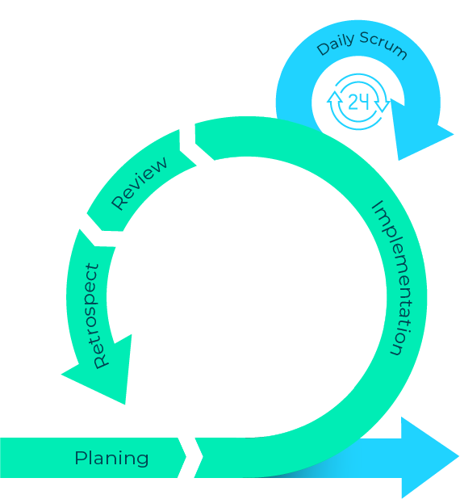

Scrum Process Overview
Product
Backlog
Potentially
Shippable
Product
Increment
2-4 Weeks
Sprint
Backlog

Slide 23
Scrum board
Not
started
Stories
In progress
Done
Story #1
Task A
Task B
Task C
Story #1
Task A
Task C
Task B
Story #1
Task B
Task D
Task A
Task C

Slide 24
Kanban Boards
Backlog
Research
Implement
Validate
Release
In progress
done
In progress
done
In progress
done
---------------------
---------------------
---------------------
---------------------
---------------------
---------------------
---------------------
---------------------
This Photo by Unknown Author is licensed under CC BY-SA

Slide 25
Agile Roles
Product owner – custodian of the vision for the product, represents the customer
Scrum Master – helps the team best use Scrum to build the product, shields the team from outside influence
Development team – build the product

Slide 26


Product Owner
The voice of the customer, acting as an expert to the development team
Defines the work to be done, and prioritises that work
Understands what’s important to the customer
The Product
Owner
The real
customer
Customers can be a very varied group of people

Slide 27


Scrum Master
Helps the team best use Scrum to build the product
Helps them to focus on the project
Protects them from organisational disruptions and internal distractions like an area where the teach cannot focus
Ensure that the team execute the Scrum process in spirit
They control the process, not to be confused with the role of the project manager who is responsible for the workload
Scrum Master
Development Team

Slide 28

Development Team
Self-organised
Work with Scrum master to develop the product
Prioritise the product backlog
Define the number of sprints
Define the stories to be tackled in each sprint
Define DONE

Slide 29
Story Points NOT Time
Traditionally when prioritising and scheduling tasks, analysts would use Complexity and Time as key factors
This has proven to be a unsatisfactory way of prioritising and scheduling workloads
Recommended approach – story points
A notional value assigned to a task that represents its complexity and perceived time to deliver
Techniques for assigning story points
Estimation Poker - https://www.planningpoker.com/

Slide 30
ACTIVITY
Agile project – pool party
Brief to follow…
2 x sprints
Follow as much of the agile process as possible
Deliverable (each sprint) is event proposal document
Think about roles, product backlog, sprint backlog, tracking etc…

